Slide 1





ACM Projects
Team [TBD]
Notes:
Feel free to use any of the other logos for the presentation

Slide 2
Colors!
here are the main colors we use at acm!
binary blue
big O(range)
ctf cyan
prototyping pink
innovation indigo
sentient scarlet

Slide 3
Meet the Team!
Notes:
Make sure that other teammates get this info!!!!!
As a suggestion, put the name of the person presenting this slide here in the speaker notes!

Slide 4
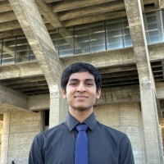
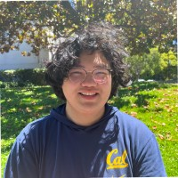
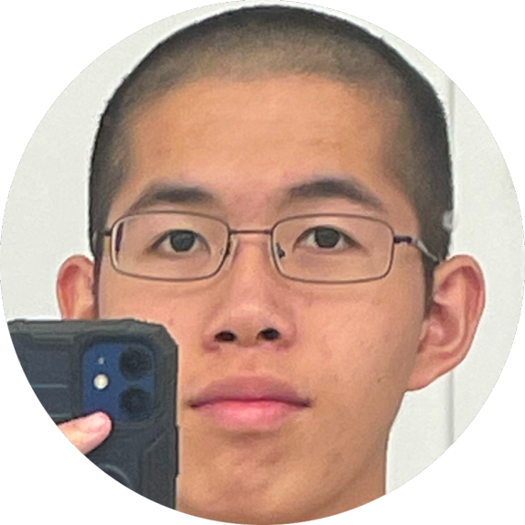
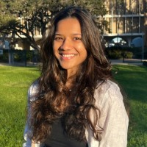
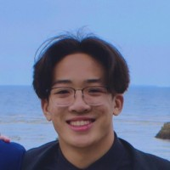

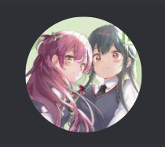
Vincent Tu
Mentor
Sia Patodia
Aryaman Dayal
Hargen Zheng
Catherine Zhang
Ryan Wong
Phillip Wu
Notes:
Make sure that other teammates get this info!!!!!
As a suggestion, put the name of the person presenting this slide here in the speaker notes!

Slide 5
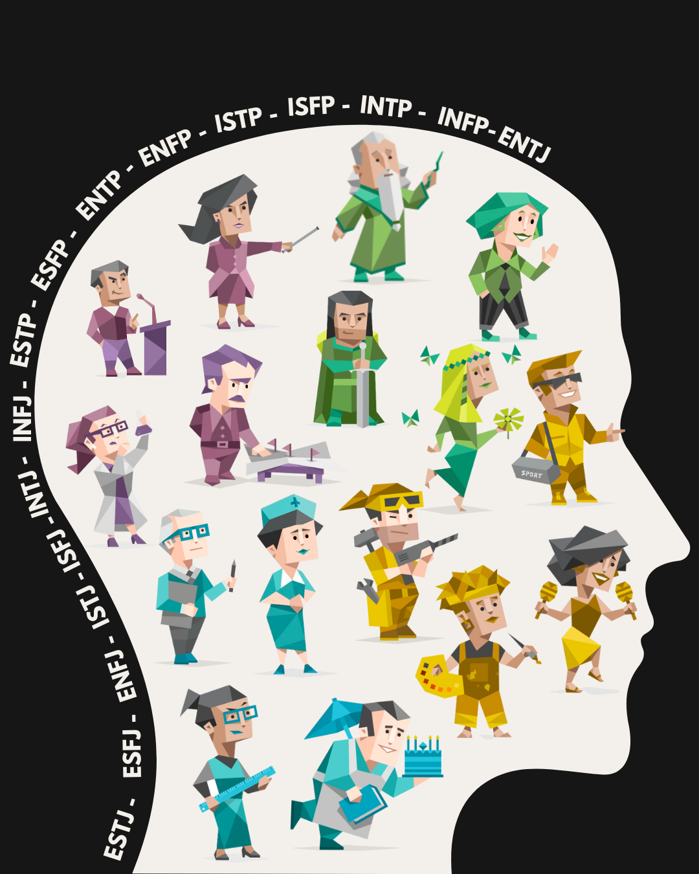

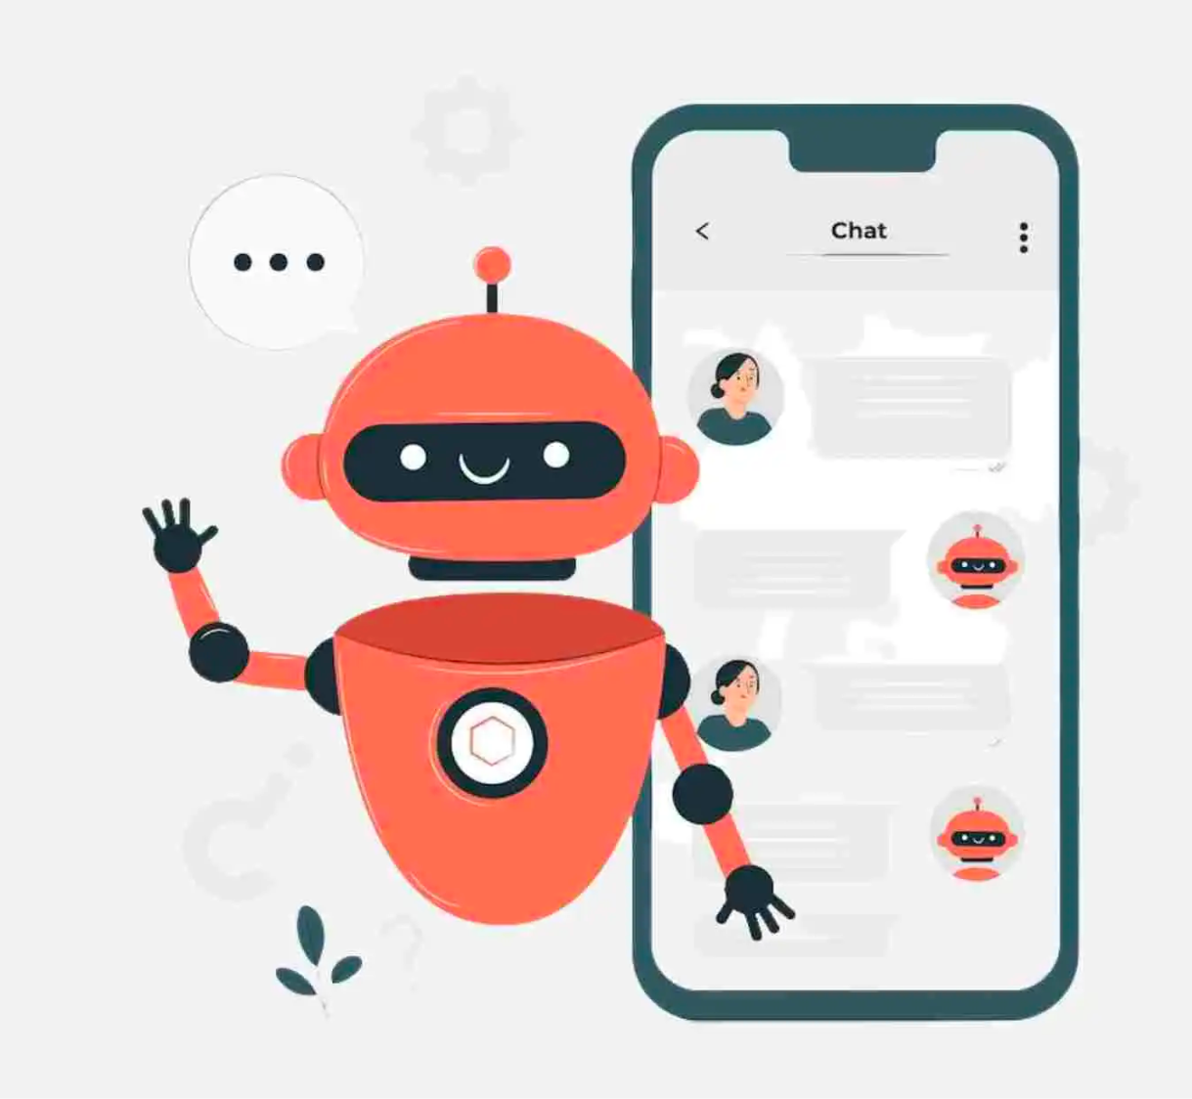
Inspiration & Background
AI Chatbot
Responds based on user input
MBTI Personality Test
Can influence texting style
Notes:
Make sure that other teammates get this info!!!!!
As a suggestion, put the name of the person presenting this slide here in the speaker notes!

Slide 6
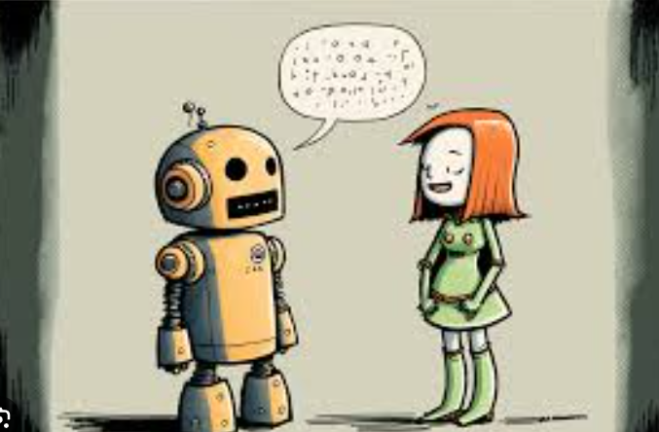
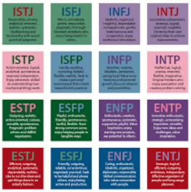
Features
Predict MBTI personality with a decent accuracy
Have a chatbot talk back to user with that MBTI personality
Notes:
This is mainly for hack teams, but other teams can use it if they like

Slide 7




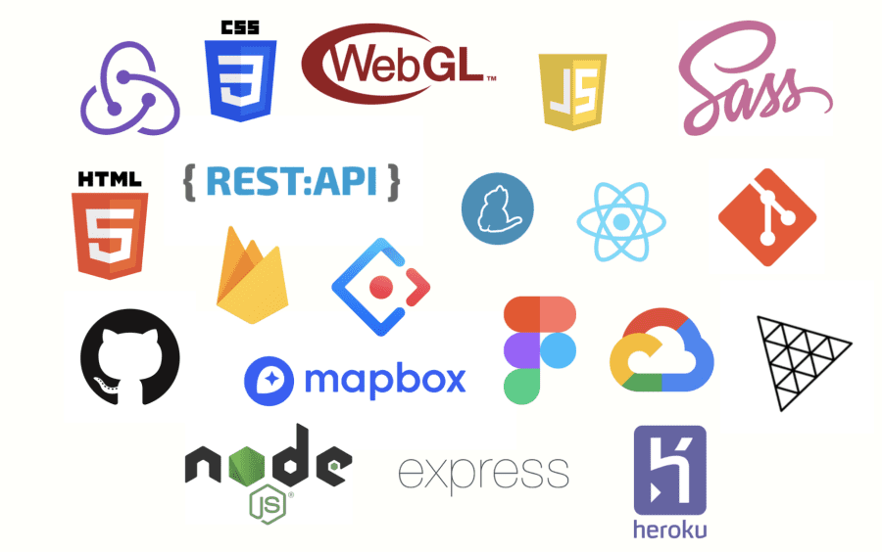








Look at our tech stack !!
Notes:
Make sure that other teammates get this info!!!!!
As a suggestion, put the name of the person presenting this slide here in the speaker notes!

Slide 8
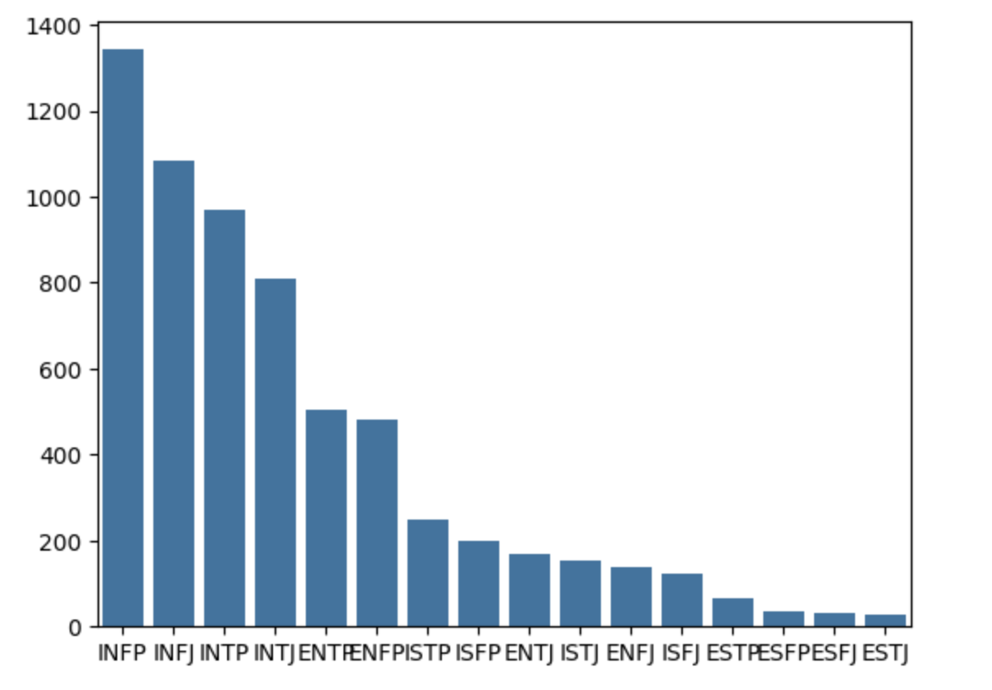
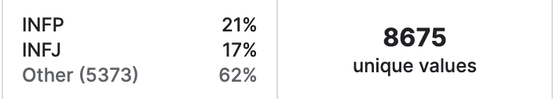
Technical Process
Dataset link: (MBTI) Myers-Briggs Personality Type Dataset
EDA results:
Dataset has more introverts (super unbalanced)
Each entry has user’s MBTI type and words from user’s last 50 posted tweets
Preprocessing:
Tokenization using BERT pre-trained tokenizer
Encode the MBTI type into integers 0-15
Only keep words between 3 and 30 characters
Notes:
Make sure that other teammates get this info!!!!!
As a suggestion, put the name of the person presenting this slide here in the speaker notes!

Slide 9
Here are the original notes vincent wrote down
Talk about dataset (e.g. dataset size, modality, feature engineering, cleaning, EDA, insights, conclusions, motivation behind this dataset)
Talk about preprocessing (tokenization, stemming, lemmatizing, etc)
Talk about the model (BERT other neural language models -> talk more about how these models are made and how they work; LSTM -> long-short-term memory loosely inspired by human brain)
Talk about the training (and finetuning), discuss training configuration and set up; if you CV, then you can also talk about that
Talk about your experiments (what worked and what didn’t work; possibly hypotheses for why things didn’t work or why things worked)
Talk inference (how do we run the model)?
Talk about the app (how did you build the app, what features does it have? etc)

Slide 10

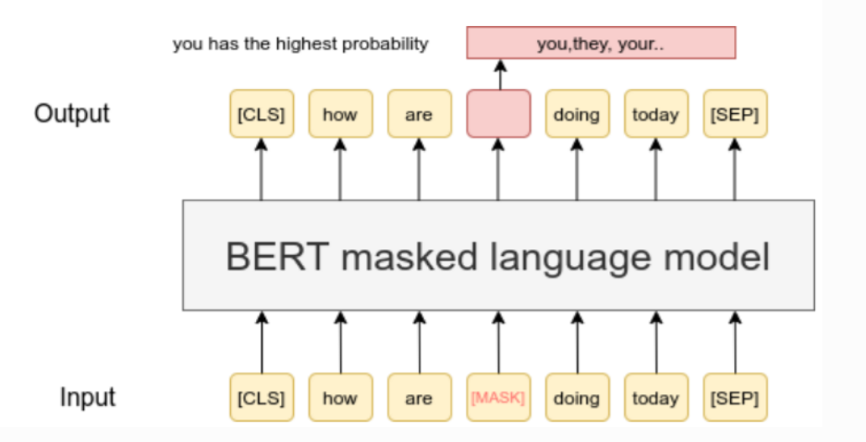
Technical Process (cont.)
Model: BERT (Bidirectional Encoder Representations from Transformers)
Unique since it is considered a bidirectional model (captures context well)
Uses a transformer architecture
Combined predicting words along with predicting if sentences belonged to each other to create the BERT model
Notes:
Make sure that other teammates get this info!!!!!
As a suggestion, put the name of the person presenting this slide here in the speaker notes!

Slide 11
Technical Process (cont.)
Training the BERT Model
Transfer learning (cold start issue due to size of parameters, limited computation power). We used Colab T4 GPU to train the model.
Embed each text input into a vector with maximum length of 256 (padding).
Shuffle the data and use 80/20 train-validation split.
Batch size of 16 (drop the remainder). This results in 433 batches in each epoch.
Add a fully connected layer with 512 hidden units, with ReLU activation function.
Use a softmax layer with 16 output units to represent the probabilities of each MBTI type, given the input text corpus.
Used the built-in Adam Optimizer with decay and Cross Entropy Loss function.
Notes:
Make sure that other teammates get this info!!!!!
As a suggestion, put the name of the person presenting this slide here in the speaker notes!

Slide 12
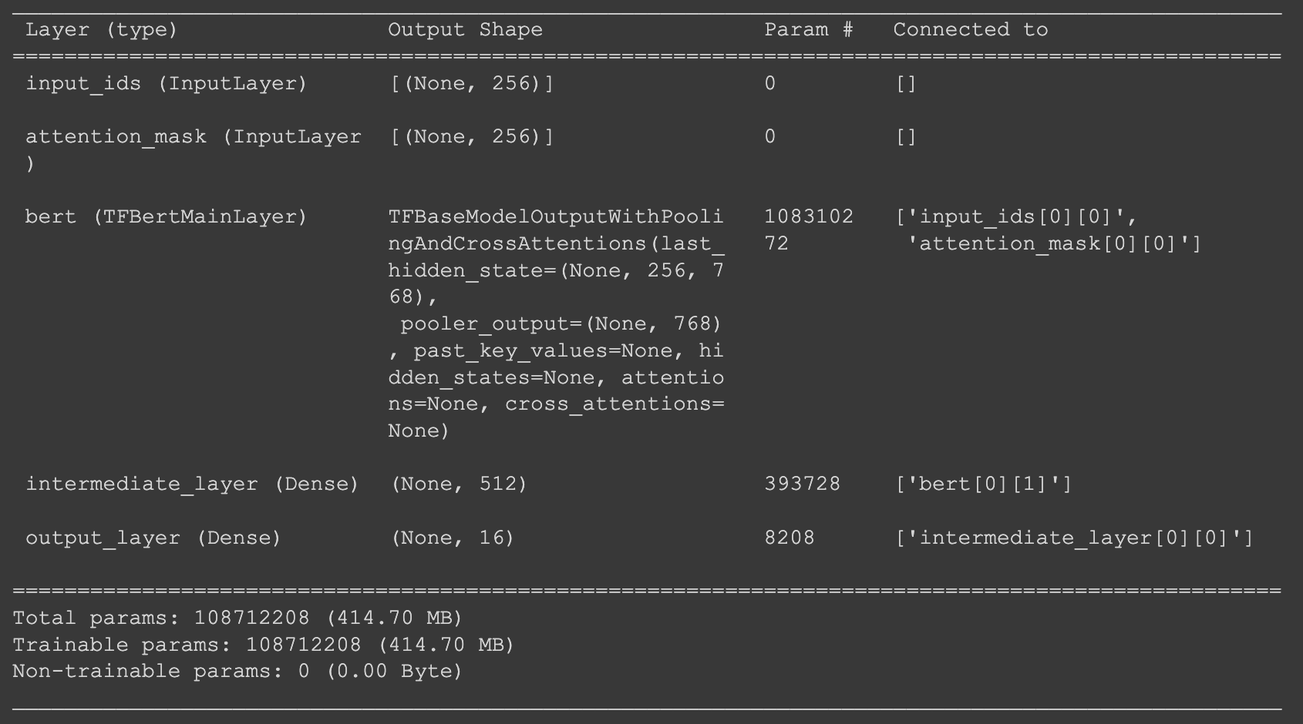
Technical Process (cont.)
BERT Model Summary
Notes:
Make sure that other teammates get this info!!!!!
As a suggestion, put the name of the person presenting this slide here in the speaker notes!

Slide 13
Technical Process (cont.)
Experiments
Though 1e-5 is the recommended learning rate for most of the transformer models, it was super slow to train for us. As a rookie I changed to 1e-4 and we were overshooting – after 1 epoch, the accuracy went from 35% down to 18% and it kept decreasing.
Used 5e-5 as learning rate and decay of 1e-6 – accuracy keeps increasing all the way to ~95% on the training set. This is way better than the original Softmax regression model, which obtained a 84% on the training set.
Could’ve tune the maximum size of word embeddings and the size of hidden layers
Notes:
Make sure that other teammates get this info!!!!!
As a suggestion, put the name of the person presenting this slide here in the speaker notes!

Slide 14

Technical Process (cont.)
Eventual Model Performance
Notes:
Make sure that other teammates get this info!!!!!
As a suggestion, put the name of the person presenting this slide here in the speaker notes!

Slide 15
Technical Process (cont.)
Inference
We clean the text corpus in the same way as we did for the training and validation examples.
Then, we used the BERT tokenizer to embed the input text corpus.
The feature vector of the input text is then fed into our transformer model, which gives us 16 probabilities corresponding to the likelihood of each personality type.
We then extract the top three most likely personalities and display to the user.
Notes:
Make sure that other teammates get this info!!!!!
As a suggestion, put the name of the person presenting this slide here in the speaker notes!

Slide 16
Technical Process (cont.)
Streamlit App
We created a Streamlit application that shows the distribution of MBTI personality types in our dataset.
User could input paragraphs of text and the app will predict their top three likely MBTI personalities using our model.
WHY TOP 3, not just 1???
After the prediction result pops up, there will be additional MBTI information of the three likely personalities, so the user can learn more about their potential MBTI type.
Notes:
Make sure that other teammates get this info!!!!!
As a suggestion, put the name of the person presenting this slide here in the speaker notes!

Slide 17
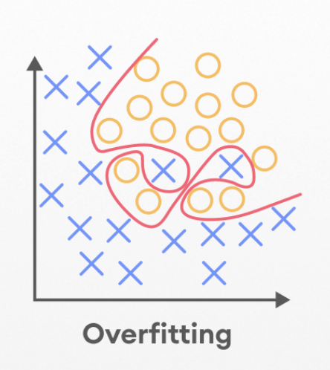
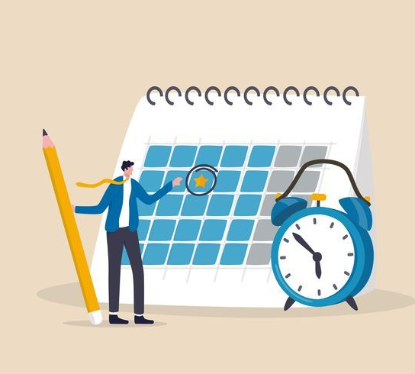
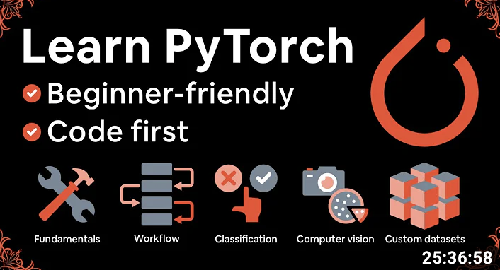
Challenges
Meeting scheduling conflicts
Balancing classwork and project
Lack of experience (PyTorch, Model Choice, Training)
Model overfitting
Notes:
Make sure that other teammates get this info!!!!!
As a suggestion, put the name of the person presenting this slide here in the speaker notes!

Slide 18
Reflection
Where do we go from here?
Smaller group sizes may make it easier to meet
Self-guided learning is difficult
Talk about how RoBERTa could potentially work better (as it was trained on a larger text corpus)
Create mobile application for interacting with chatbot
Learn more about NLP and deep learning
Notes:
Make sure that other teammates get this info!!!!!
As a suggestion, put the name of the person presenting this slide here in the speaker notes!

Slide 19
Demo
Notes:
Make sure that other teammates get this info!!!!!
As a suggestion, put the name of the person presenting this slide here in the speaker notes!

Slide 20
Questions?
Notes:
Make sure that other teammates get this info!!!!!
As a suggestion, put the name of the person presenting this slide here in the speaker notes!

Slide 21

Thank you!
Mentor: Vincent Tu LinkedIn | GitHub
Catherine Zhang LinkedIn | GitHub
Aryaman Dayal LinkedIn | GitHub
Hargen Zheng LinkedIn | GitHub
Sia Patodia LinkedIn | GitHub
Phillip Wu GitHub
Ryan Wong LinkedIn | GitHub

